Slide 1

Street smarts/personal safety
DelNorte Baptist
TRISH HOFFMAN
Albuquerque Police Dept
thoffman@cabq.gov

Slide 2
Who is in charge of your personal safety?
YOU

Slide 3
Top 3 things to remember
1. Be aware of your surroundings
2. Be observant
3. MINDSET
  Flight
  Fight
  Freeze
  “don’t hurt me, don’t hurt me
  I’m not going down without a fight

Slide 4
Joshua 1:9
Have I not commanded you? Be strong and courageous; do not be afraid; do not be discouraged; for the Lord your GOD will be with you wherever you go

Slide 5
It all starts with?
The way you walk into a room?
Command that room, take ownership to this
Commit how this is going to go

Slide 6
Where is your personal space?
Front, side , and rear of you
How do you walk into a room? Distracted? Cell phone in hand, head in clouds
How should you walk? Command the room
How do you carry yourself?

Slide 7
Scenario#1
How do you stand at the ATM?
How do you stand at the gas station?

Slide 8
Scenario 2
You are standing at the bank and an armed masked individual comes in and demands $
?????

Slide 9
What do you do ?
Be a good witness
What to look for?
  Description
  What actually happened
  Weapons?
  Where did they go?

Slide 10
Get involved?
Be the go between during a fight?
Could you be part of the problem?
Could you make matters worse?
Is it worth it?

Slide 11
See it, Sense it, Follow through
? How

Slide 12
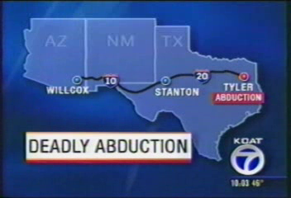
Scenario #2

Slide 13
What can we learn?
What should we do?

Slide 14
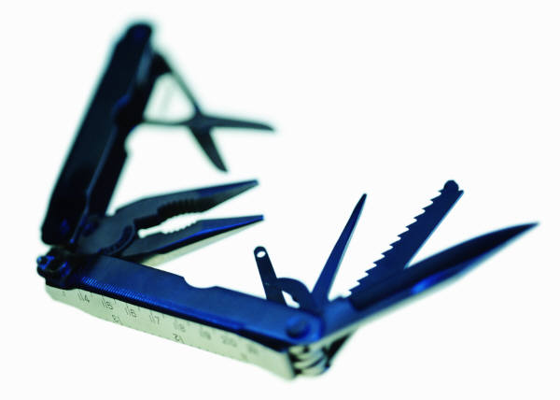


What can you carry for protection?
Keys
Pen
Knife
Taser
Gun
flashlight

Slide 15
Can you get in trouble for protecting yourself?
Where is the line drawn?
Can you protect ???
Self
Car
Home
Family??

Slide 16

Alcohol and drugs
Do they heighten our awareness?
Or hinder?

Slide 17

Top things to remember
Be aware
Be observant
MIND SET for SURVIVAL
Be proactive, not reactive

Slide 18


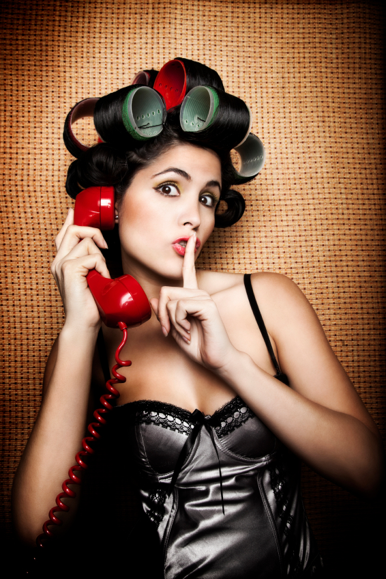
FB//Linkdin, Social media
We all know you are on vacay,,,

Slide 19
????????????????????????
Where do you go from here?
Realize there is so much out there
Sustainability training,,,keep it going
Different forms of training
Watch videos
Have conversations
Take another class

Slide 20
“I am not afraid, I was born to do this”
                Joan of Arc
                I will sacrifice so that others may live free,
                The wicked flee when no one pursues, but the righteous are bold as a line
                Proverbs 28

